Slide 1

CompaniOn
Elderly Care Solution

Slide 2

Context
Description of the Business Idea
Description of Services
Market Analysis
Desription of Implementation
Company Structure
Financial Plan

Slide 3

Description of the Business Idea
3D AI Assistant for eldery people and their family members with inovative features, and a subscription based income model
3 Shareholders with 33.33% of shares each
Remote work and digital project managment tools that form non existing costs on location managment and facilities

Slide 4









Description of Services
Users are:
Basic User
Family Member
Key Services and FAB:
AI Assistant
Reminders
SOS Button
Location tracking
Dangerous Interacion Warning
Family Accounts
Customisable Options

Slide 5

COGS in a year with a team of 10 working on the project and 28,500 customers:
$402,124
Tiered Subscriptions Revenue Model:
Free
Start $9.99
Pro $19.99
Enterprise – Custom Pricing
GM, Revenue per year and Total Profit with 28,500 customers:
80% GM
Revenue Per Year $2,033,040
Total Profit $1,630,916
Future Product Strategy:
Advanced Emotional Interaction
Health Monitoring and Device Integration
Personalised Recommendations
Social Connectivity
Mood and Activity Tracker
Emergency System
Rewards and Engagment
Support for Cargivers
and Family
Members
Accessibility
Integration with
Communitys

Slide 6
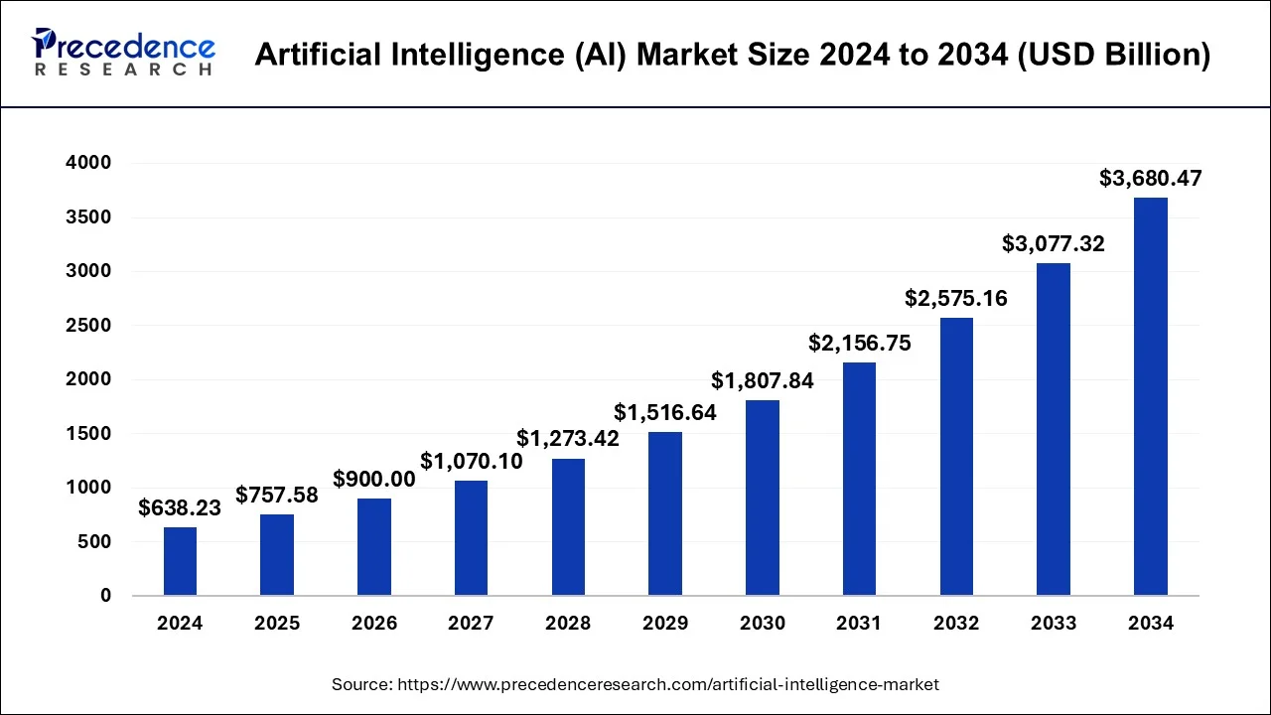
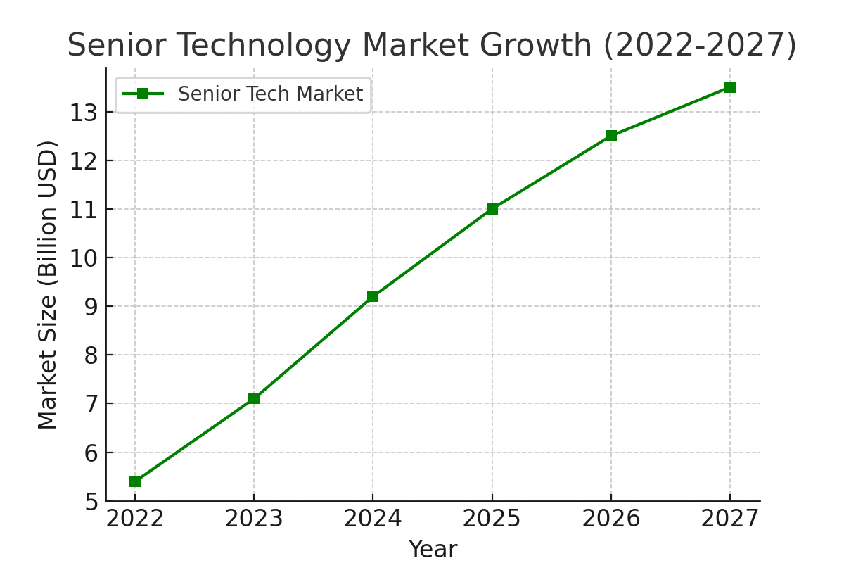



Market Analysis
Market Analasys shows these factors:
Growth of the Senior Care Market
Tehnological Advancments in Elderly Care
Dementia and Mental Health
The Market Trends are:
AI Market booming (over 1.8 trillion in profit by 2030)
Untaped sectors for expansion example: healthcare
Competitors:
Replika
Papa Pal
Cogni Fit
Lumiosity
Target Audience:
Elderly Users (65+)
Family Members (30-55)

Slide 7


Description of implementation/ Launch strategies
Ads targeting people age 35-55 on facebook with an extensive and early outreach to health offices and nursing homes
Nursing homes will be offered an enterprise plan for $999.99 a month for all of their users
The Action Plan (April 2025 – April 2026) includes:
Onboard 60 Health Institutions
215 Active Users
Platform Branding

Slide 8

REVENUE SUMMARY OVER THREE YEARS
Sales | YearI | Year II | Year III
User Subscriptions | ~$1,620 | ~$8,181 | ~$20,861
Healthcare Inst. Subscriptions | ~$44,000 | ~$112,200 | ~$286,110
Total Sales | $45,620 | $120,381 | $306,971
Production costs | Year I | Year II | Year II
User Subscriptions | ~$25,000 | ~$65,000 | ~$100,000
Healthcare Inst. Subscriptions | $0 | $0 | $0
Total Expenses | $25,000 | $65,000 | $100,000
Year One: +$20,620 | Year Two: +$55,381 | Year Three: +$206,971

Slide 9
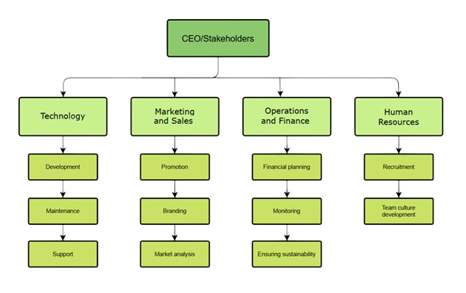
Company Structure
The company will be structured:

Slide 10


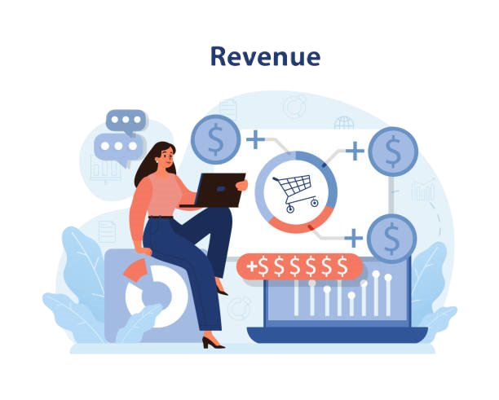
Financial Plan
Income and expenditure projection:
 | Year I | Year II | Year III
Fiscal value | $45,620 | $120,381 | $306,971
Total COGS | $25,000 | $65,000 | $100,000
Gross margin | $20,620 | $55,381 | $206,971
Gross margin % | 45.2% | 46% | 67.5%
OPEX
Marketing and branding | $9,500 | $10,000 | $15,000
Operating expenses (salaries, legal and accounting services) | $7,000 | $30,000 | $50,000
Other and unforeseen costs | $3,000 | $5,000 | $10,000
Total expenses | $19,500 | $45,000 | $75,000
EBITDA | $1,120 | $10,381 | $125,971
EBITDA % | 5.74% | 8.7% | 41.1%
Income / profit tax | $120 | $381 | $5000
Interest expenses | 0 | 0 | 0
Depreciation | 0 | 0 | 0
Impairment | 0 | 0 | 0
Net profit | $1,000 | $10,000 | $120,971
Net profit % | 2.2% | 8.3% | 40%
CAPEX | $1,000 | $10,000 | $120,971
Start up budget:
Needs | $49,500
Expenses / first year
Software Development & Infrastructure | $10.000
Marketing & Branding | $9.500
Operational Costs (Salaries, Legal, Accounting) | $10,000
Cloud Services & Maintenance | $8,000
Customer Support & Administration | $7,000
Miscellaneous & Contingency Fund | $5,000
Total Start-up Expenses | $49,500
Total needs | $49,500

Slide 11

THANK YOU !

